Slide 1
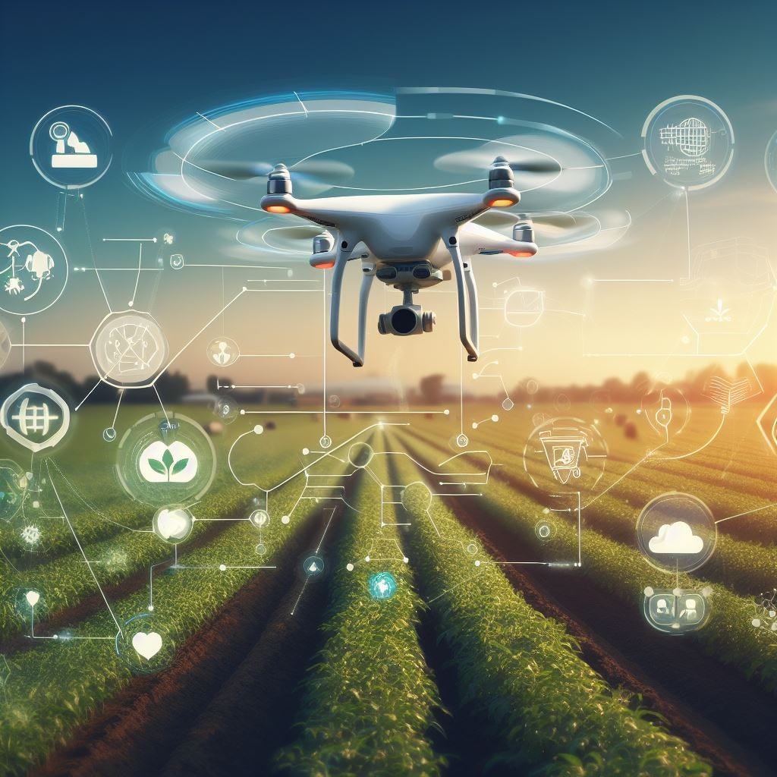
DSCI-6011
Deep Learning Project
- Vennela Kosanam
- Supraja Kodiganti

Slide 2
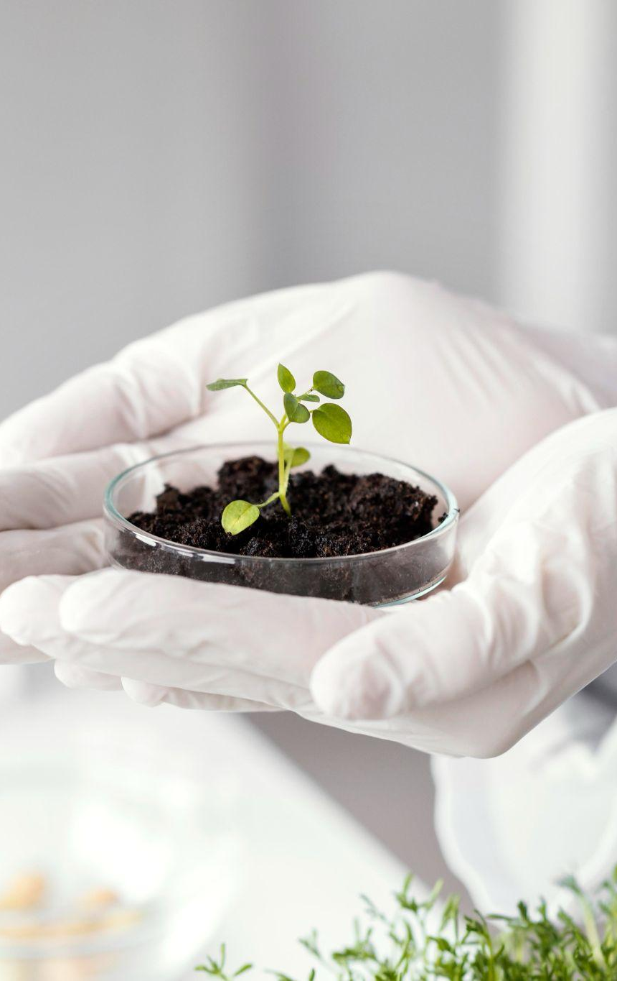
Cotton Plant Disease Prediction

Slide 3
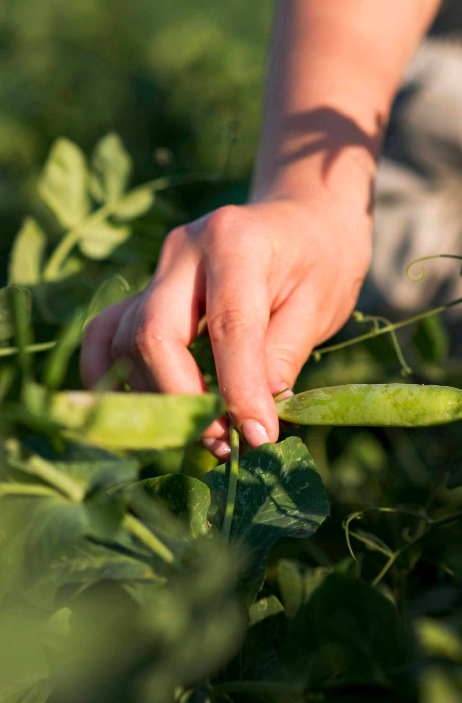
Objective
The objectives of the project is to classify cotton plant images into categories such as diseased cotton plant, diseases cotton leaf, fresh cotton plant, fresh cotton leaf using pre-trained convolutional neural network (CNN) like RESNET50, InceptionV3 through transfer learning.
To predict whether the plant/leaf is diseased or not.

Slide 4
Why is this project worth doing?
Crop Protection and Sustainability
Economic Impact
Resource Optimization
Food Security and Poverty Alleviation
Technology Adoption in Agriculture
Climate Resilience
Knowledge Generation and Sharing
Public Health Concerns

Slide 5
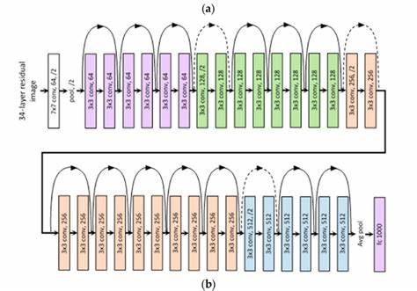
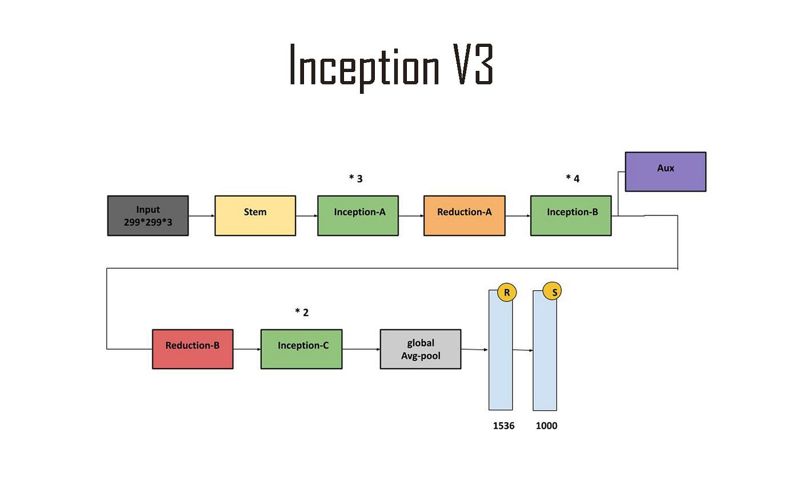
Review the state of the art

Slide 6
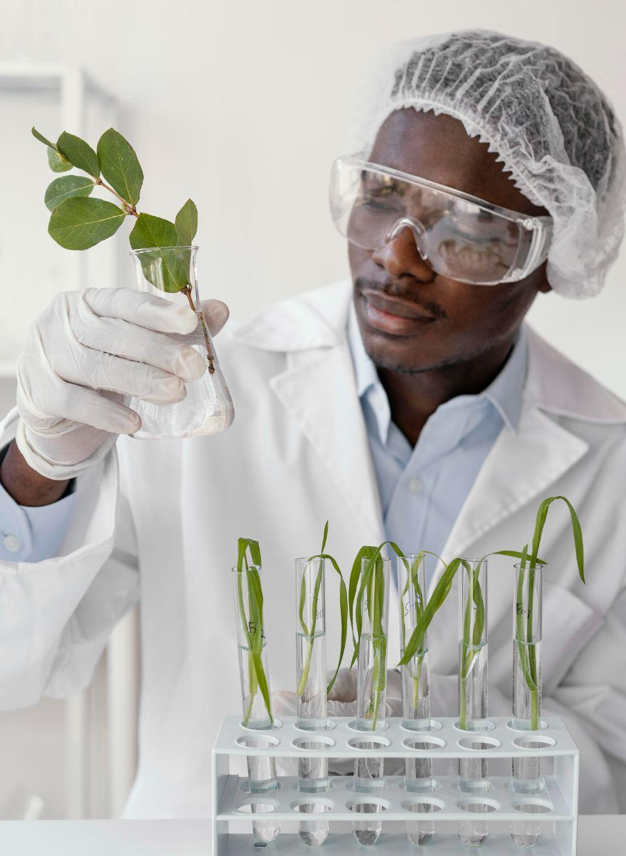
Approach
Dataset: Cotton Disease Dataset (kaggle.com)
Model: ResNet50, InceptionV3
Training: Transfer Learning, we employ a pre-trained Convolutional Neural Network (CNN) model as a starting point for the classification task.

Slide 7
Proposed Deliverables:
Cotton Disease Prediction Model
Performance Evaluation Report
Develop a deep learning-based model capable of predicting cotton diseases based on input environmental and crop-related factors
Produce a report summarizing the performance evaluation results of the prediction model, including metrics such as accuracy, precision, recall, and F1-score.

Slide 8
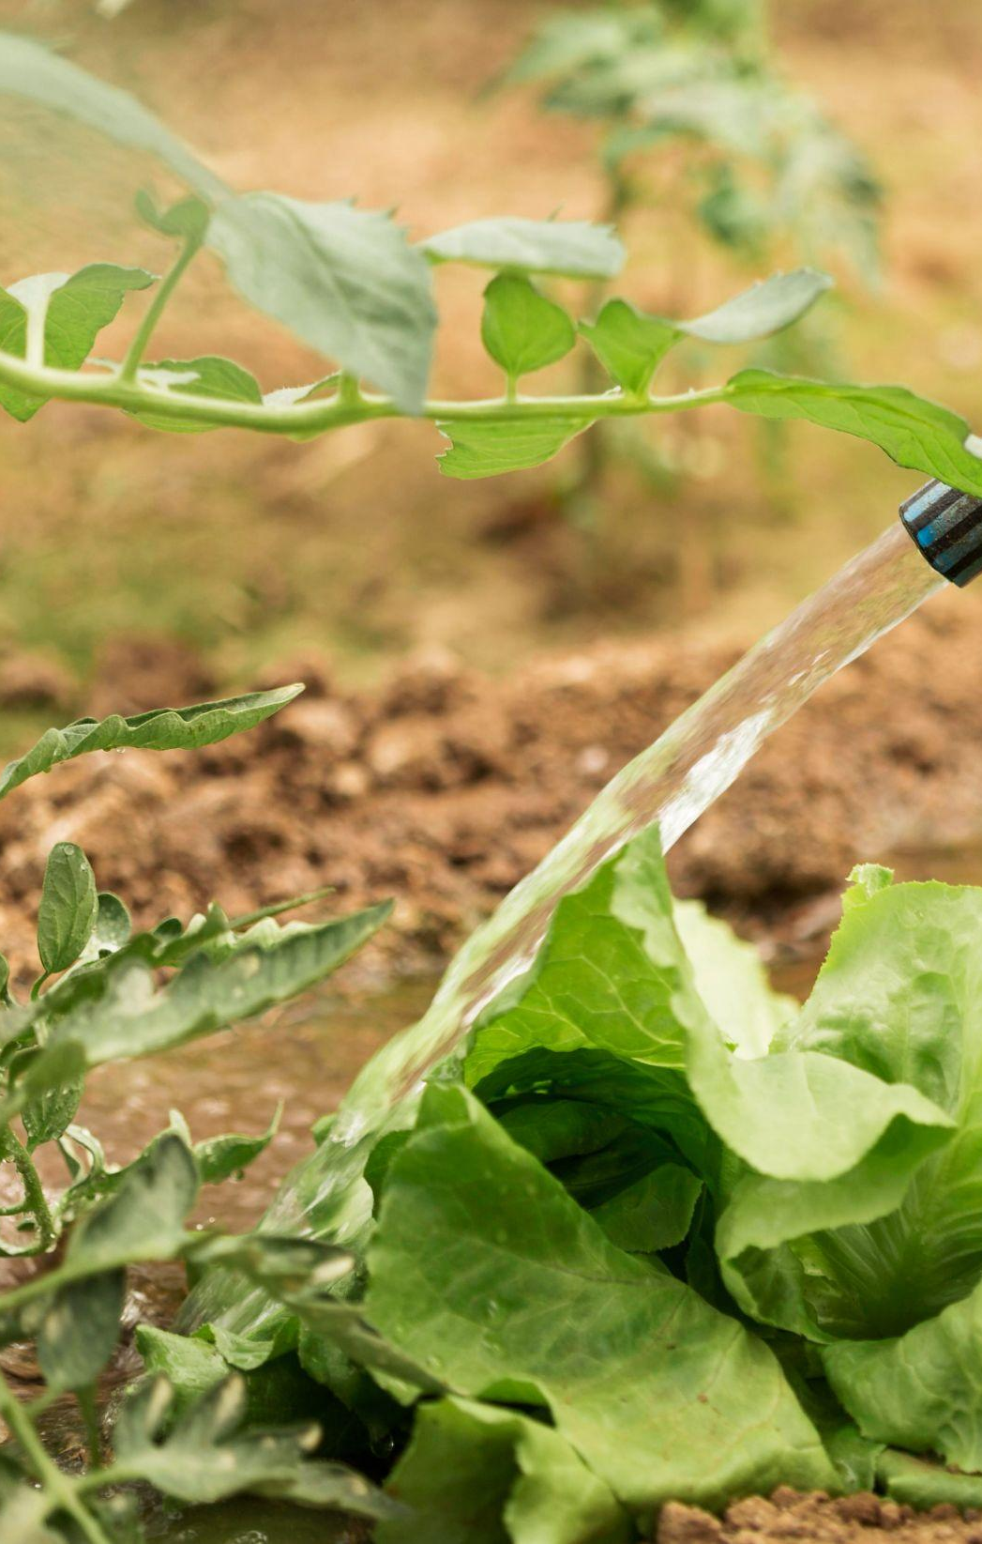
Evaluation Methodology:
The evaluation methodology to be used in the project primarily involves training a convolutional neural network (CNN) model on a dataset of cotton plant images and then assessing its performance on a separate test set. This process encompasses several key steps and metrics to determine the model's effectiveness in classifying images into the correct categories (diseased cotton leaf, diseased cotton plant, fresh cotton leaf, and fresh cotton plant).

Slide 9
References
Nadeem, Rana. (2022). Machine Learning Model of Plant Disease Prediction: Cotton Leaf Curl Virus (CLCV) on Cotton Crop. Quaid-e-Awam University Research Journal of Engineering, Science & Technology. 20. 1-10. 10.52584/QRJ.2002.01.
Anwar, Sohail & Soomro, Shoaib & Khan, Shadi & Patoli, Aamir & Kolachi, Abdul. (2023). Performance Analysis of Deep Transfer Learning Models for the Automated Detection of Cotton Plant Diseases. Engineering, Technology & Applied Science Research. 13. 10.48084/etasr.6187.

Slide 10


